Slide 1
Machine Learning

Slide 2
M/L
Supervised Learning (Y is known)
Unsupervised Learning ( Y is unknown)

Slide 3
Supervised Learning
Regression Algo ( Y is Continuous )
Classification Algo ( Y is Discrete )

Slide 4
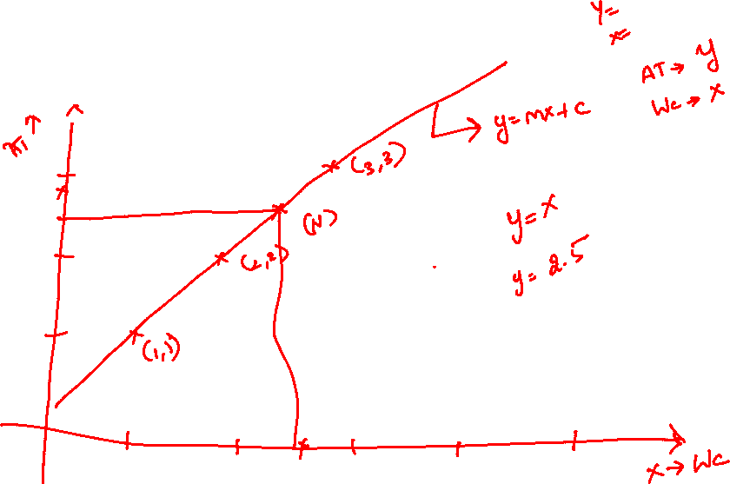
Linear Regression

Slide 5
Steps in M/L
Data
EDA
Feature Engineering
Split the data into two (train / test ) (80:20)
Model the data (train)
Evaluate the model (Test)
Choose the best model
Deployment

Slide 6
data
Import dataset
EDA
Explore dataset
Graphs, unique , value counts, isnull
FE
Convert the data
Apply thing learnt in EDA
Split data
Data Splitting (80:20)
Ml Model
Regression
Classification
Model Evaluation
Test data
Deployment
Best model

Slide 7
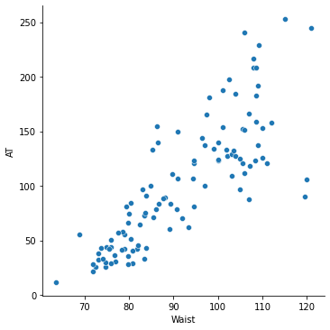


Simple Linear Regression

Slide 8

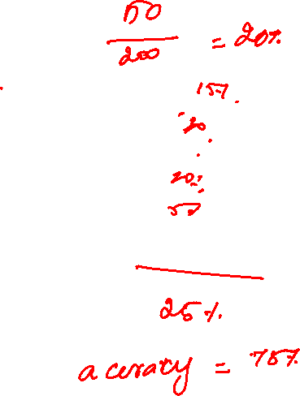




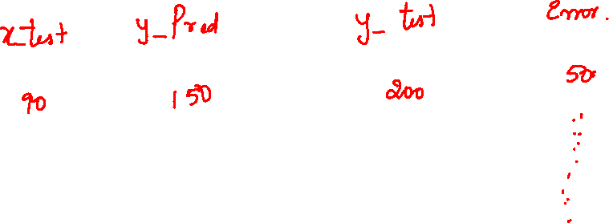

Slide 9
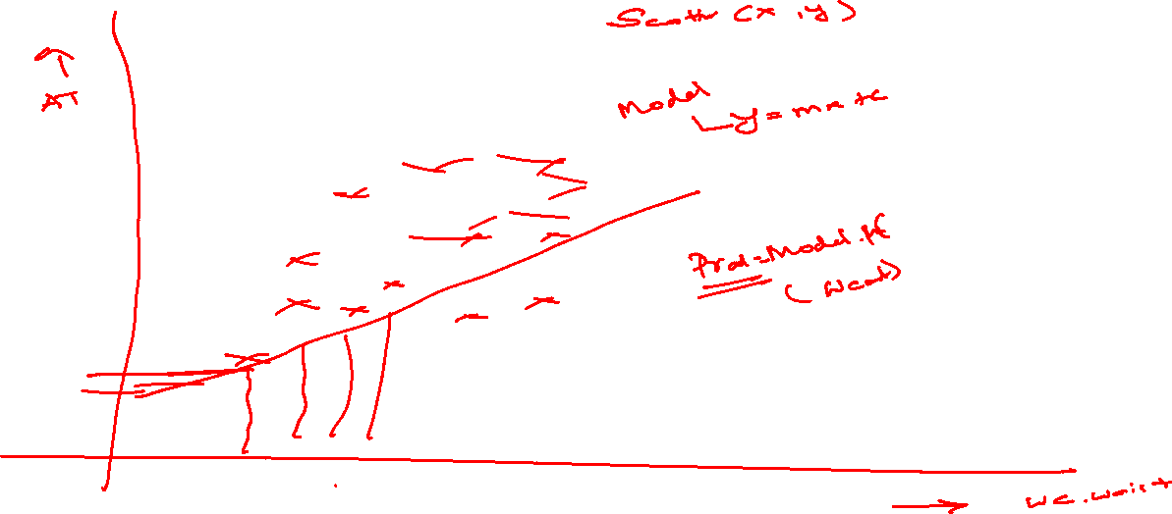

Slide 10
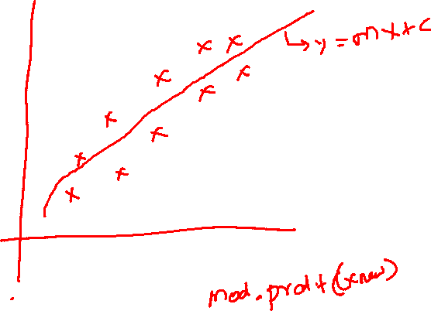
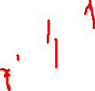

Slide 11
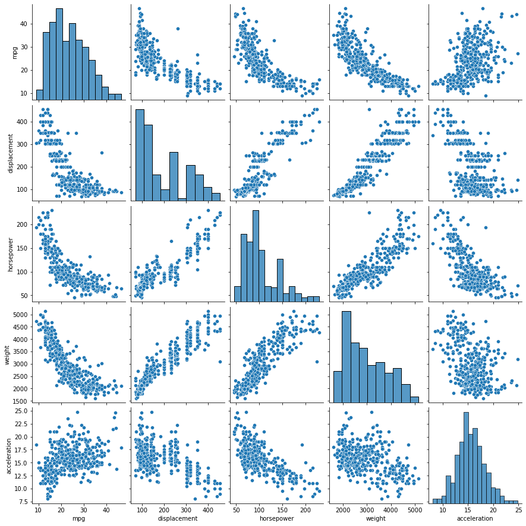


Slide 12
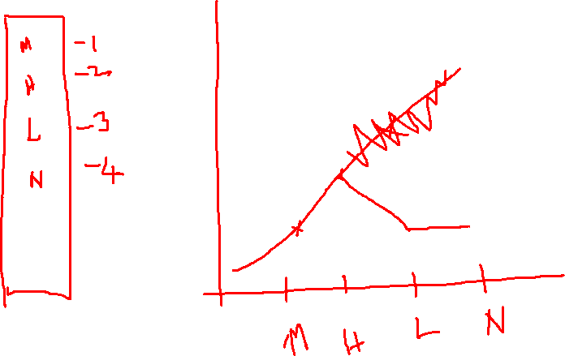

Slide 13
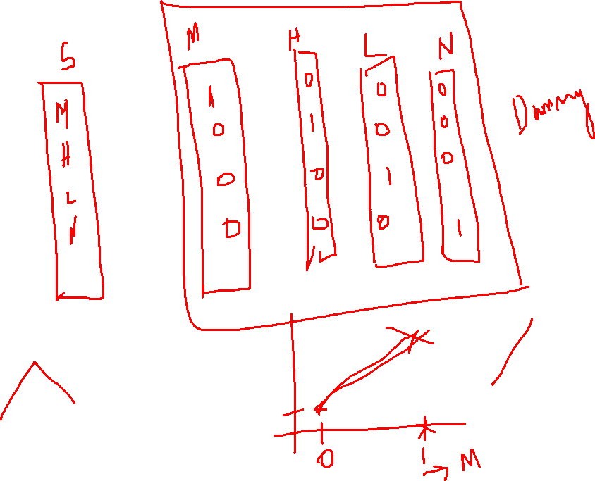

Slide 14
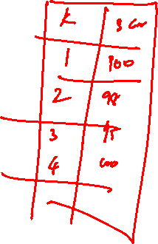

Slide 15
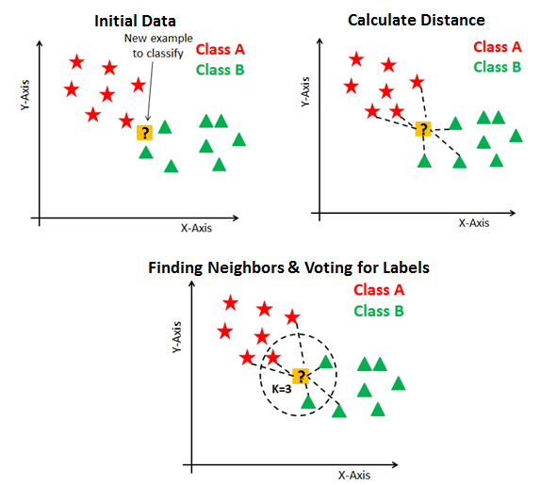
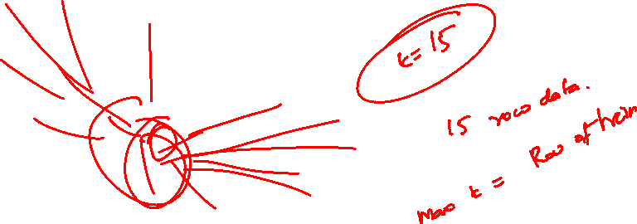
Sweetness
Softness

Slide 16

Euclidean Distance = $\sqrt{\sum{(Xi −yi)}}$²

Slide 18
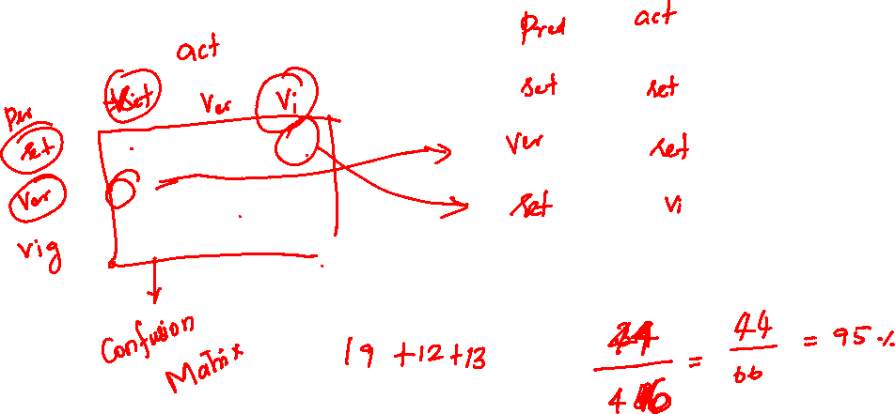
19 0 1
1 12 0
0 0 13

Slide 19
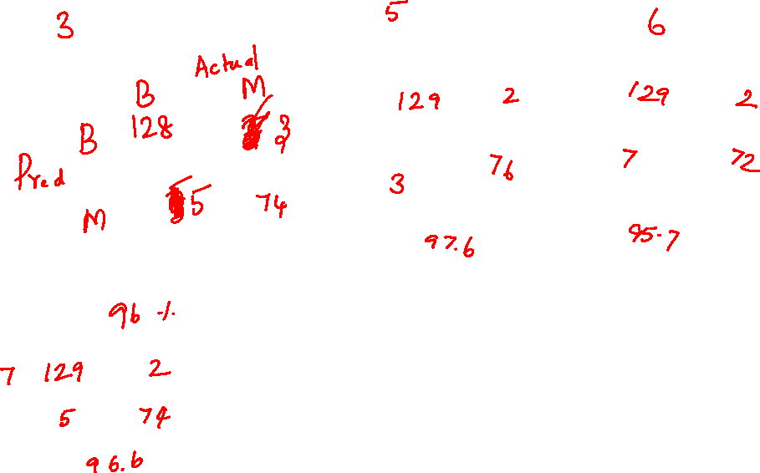

Slide 20
Regression Algorithm
Y should be continuous

Slide 21
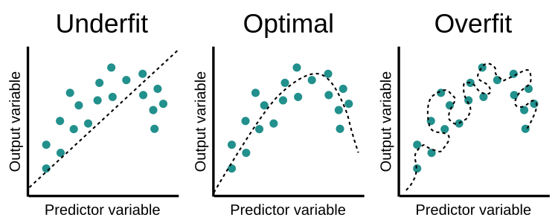

Slide 22
Decision Tree
Location
Movie
Mall
Cinema
language
Hollywood
Bollywood
Genre
Thriller
Romcom
Radhe
Avatar 2 : The way of waters
Tumbad
Jab we met

Slide 23
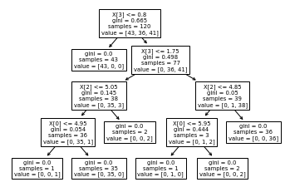

Slide 24
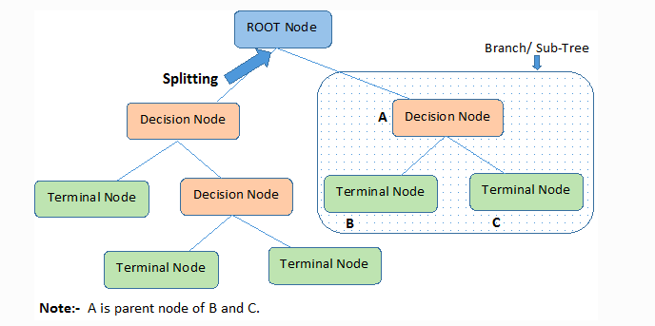

Slide 25
Random Forest
Language
Movie
Hollywood
Bollywood
Location
Avatar 2 : The way of waters
Genre
Thriller
Romcom
Jab we me
Location
Mall
Cinema
Tumbad
Radhe
Location
Movie
Mall
Cinema
language
Hollywood
Bollywood
Genre
Thriller
Romcom
Radhe
Avatar 2 : The way of waters
Tumbad
Jab we met

Slide 26
Adaboost - Stumps
Language
Movie
Hollywood
Bollywood
Avatar 2 : The way of waters
Radhe
Location
Movie
Mall
Cinema
Radhe
Tumbad

Slide 27
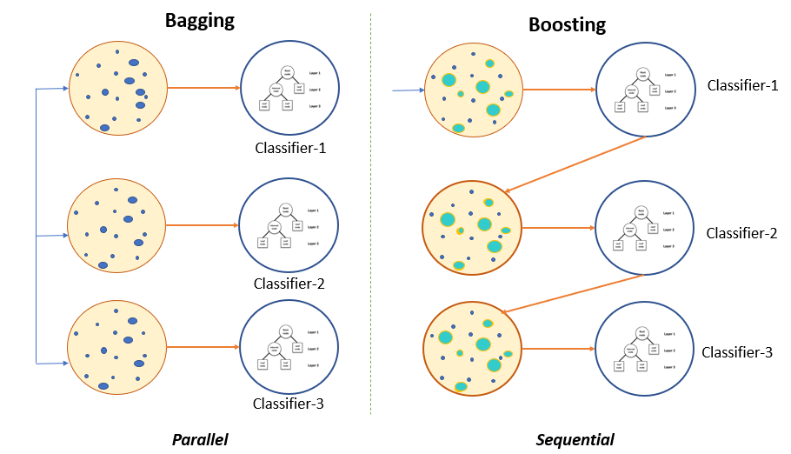

Slide 28
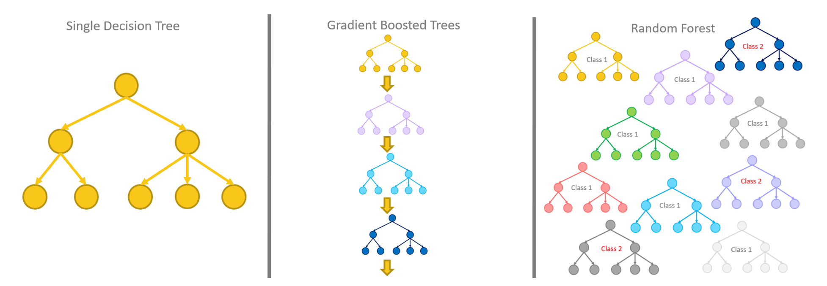

Slide 29
ML
Regression
Unsupervised
Supervised
Classification
Linear
Decision Tree
Random Forest
Adaboast
Gradient Boasting
XgBoast
Random Forest
Adaboast
Gradient Boasting
XgBoast
KNN
Decision Tree
Polynominal Regression
Dimensionality reduction (PCA)
Clustering

Slide 30
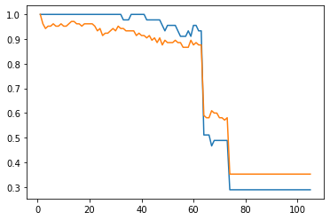
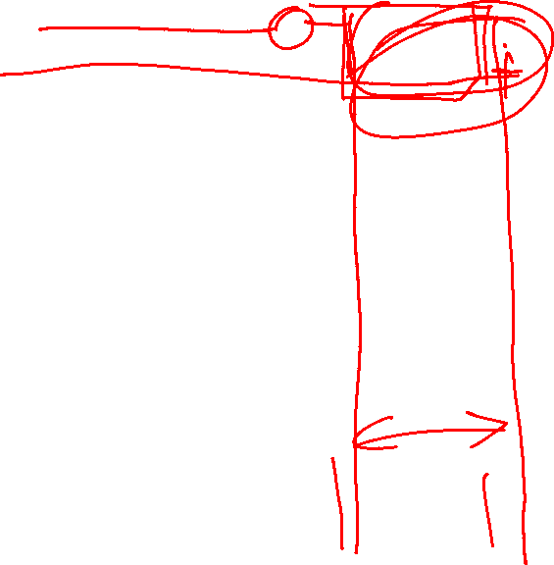

Slide 31
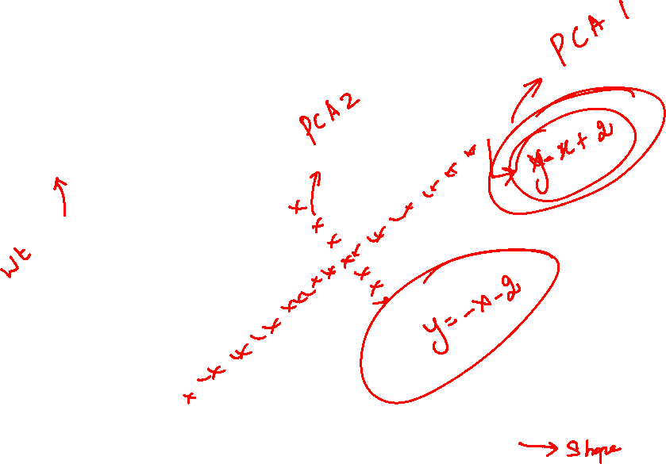
Unsupervised Learning

Slide 32
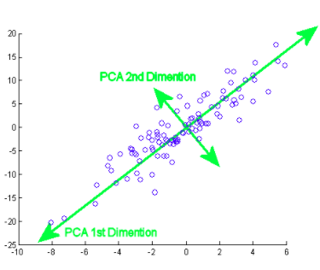
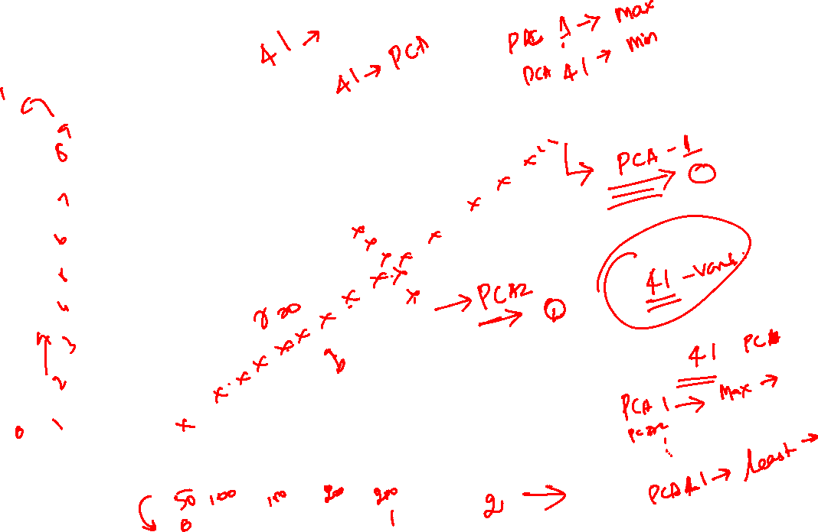

Slide 33
Python Data Science Handbook by Jake Vander Plas
Python Cookbook by David Beazley and Brain K Jones
Learn Python the Hard Way
by Zed A Shaw
Python for Data Analysis by Weis McKinney
Machine Learning with Python Cookbook by Chirs Albon
Hands On Machine Learning with Scikit Learn and Tensorflow by Ayrelien Geron
Data Visualization in python by Daniel Nelson
Data Science from Scratch by Joel Grus
Think Stats by Allen B Downey
The Art of Statistics Learning from Data by David Spiegelhalter
Introducing Data Science by Davy Cielen et.al

Slide 34
10 Best Free Websites To Learn More About Data Science And Machine Learning | by Bharath K | Towards Data Science

